Slide 1

ASANSOL ENGINEERING COLLEGE
PROJECT NAME :
URBANKART ECOMMERCE
PROJECT GROUP NO: 5
GROUP DETAILS
Suraj Goswami (Roll No.: 10800221012)
Arindol Ghosh (Roll No.: 10800221100)
Binoy Gorai (Roll No.: 10800221117)
Debashis Kar (Roll No.: 10800221120)
Under the guidance of
Mr. Santu Mondal
(Assistant Professor)

Slide 2
CONTENTS
CONTENTS | PAGE NO
Project Overview Details(Why we selected this Framework) | 3-5
Sample Picture of This project | 6
Understanding The Basic | 7
Special Features | 8-14
Fundamental Features | 14-17
Payment Gateway | 18,19
DFD | 20 , 21
ERD | 22
Result & Conclusion | 23
Thank You | 24

Slide 3
URBANKART ECOMMERCE
Urban Kart is an e-commerce platform with key features like Home, Product, Category, Login, Register, and Forgot Password. It offers category-wise selection, a search bar for model-based searches, and displays detailed product information. Users can register, log in, reset passwords, purchase products, and receive email notifications. The advanced admin dashboard includes multiple admin features, profile/password management, and user control. Both users and admins can update profiles and passwords.

Slide 4
Why we selected this Spring Boot Framework
Rapid Development: Spring Boot offers auto-configuration and embedded servers, reducing setup
time compared to traditional Spring and other frameworks like Django or Express.js.
Microservices Support: Spring Boot simplifies the creation of microservices, which are ideal for
scaling eCommerce applications. Alternatives like Ruby on Rails may require more effort
to integrate microservices.
Robust Ecosystem: Spring Boot integrates seamlessly with the Spring ecosystem
(Spring Security, Spring Data, etc.), providing ready-made solutions for security and data management.
Scalability: Its ability to handle large-scale projects with high traffic surpasses some
frameworks like Laravel, which may require additional optimization for heavy loads.
Community Support: A large community ensures extensive documentation, libraries,
and quick resolutions to issues, unlike smaller ecosystems.
Performance: Java-based Spring Boot offers excellent performance and is better suited
for high-performance applications than interpreted languages like Python (Django).

Slide 5
Cross-platform: Unlike PHP frameworks, Spring Boot runs effortlessly across different operating
systems.
Integration: Supports easy integration with cloud services (AWS, GCP) and APIs, a critical need
for modern eCommerce.
Security: Built-in features like authentication and authorization using Spring Security surpass basic
tools in Express.js.
Flexibility: Allows developers to choose tools and libraries, unlike opinionated
frameworks like Ruby on Rails.
RESTful APIs: Easy development of APIs using Spring Boot is more efficient compared to
Flask or Express.js.
Testing: Comprehensive testing support with tools like JUnit makes it superior to some
PHP-based frameworks.
Modularity: Encourages modular design, ideal for large-scale eCommerce projects.
Enterprise-grade: Trusted by enterprises, making it a reliable choice for critical
eCommerce platforms.

Slide 6
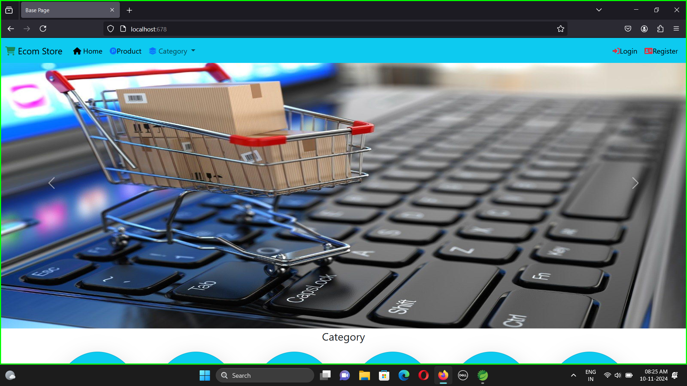
Sample Pictures of This Project

Slide 7
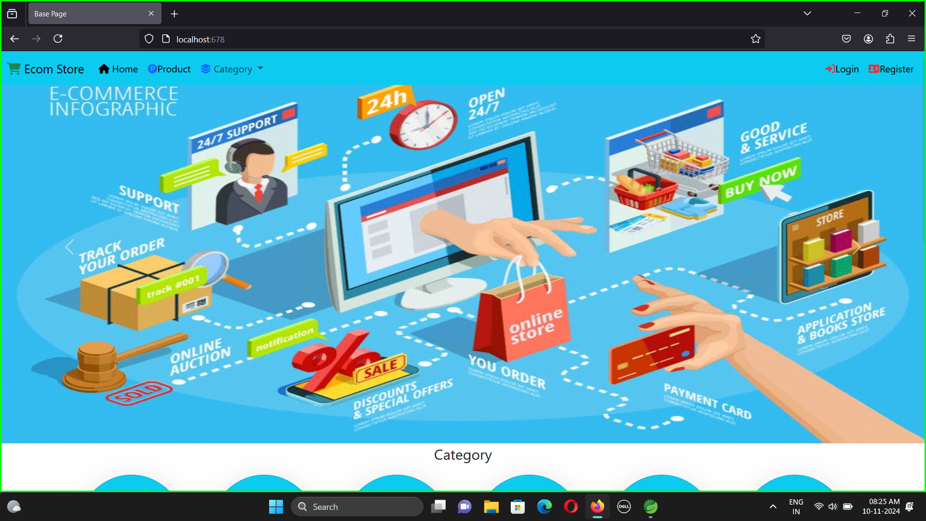
Understanding the Basics
The Urban Cart Ecommerce Project is a Spring Boot-based web application for online shopping. It integrates Spring Boot Dev Tools , Thyme leaf for UI, Spring Web, Lombok for simplified coding, and Spring Data JPA for database access with MySQL Connector. Spring Security ensures user authentication, while SMTP handles email notifications. The project supports product browsing, cart management, secure checkout, and admin control, delivering a secure and seamless e-commerce experience.

Slide 8
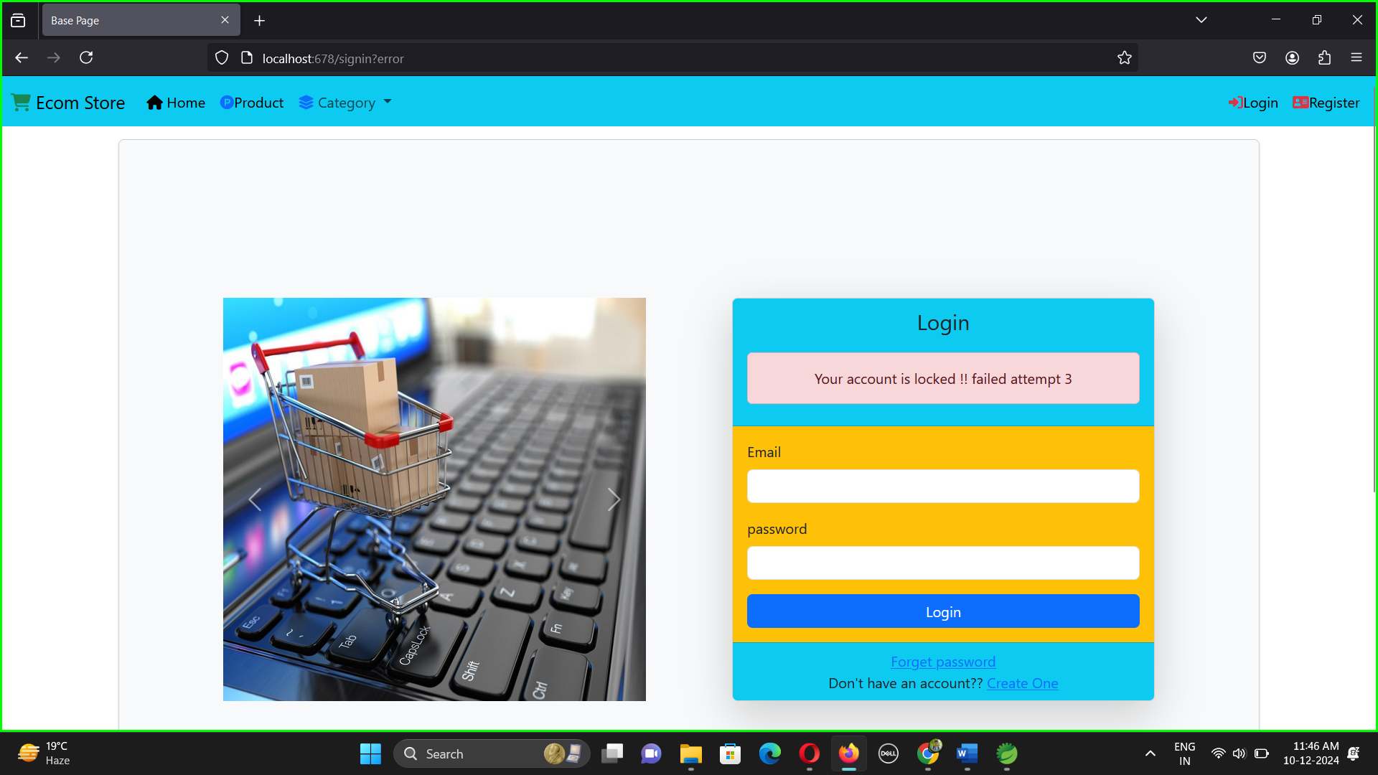

SPECIAL FEATURES
Special Discount Charges: Amazon charges a commission ranging from 7% to 20% on sales, whereas our website offers attractive discounts between 4% and 12%.
Display Quality: There are limited opportunities to directly control how a product is displayed.
Resolve Security Risk:
Security Risks (Addressed with Spring Security):
1. Block and unblock user accounts.
2. Limit login attempts for added security.
3. Enable "Forgot Password" functionality via email for users with 2FA enabled.
4. Minimize identity theft risks with quick recovery access if the platform is compromised.

Slide 9
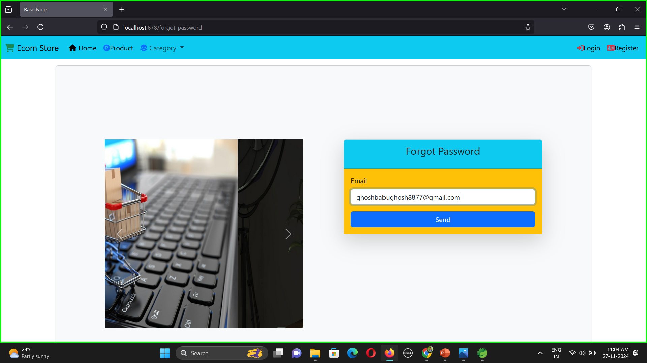

Slide 10
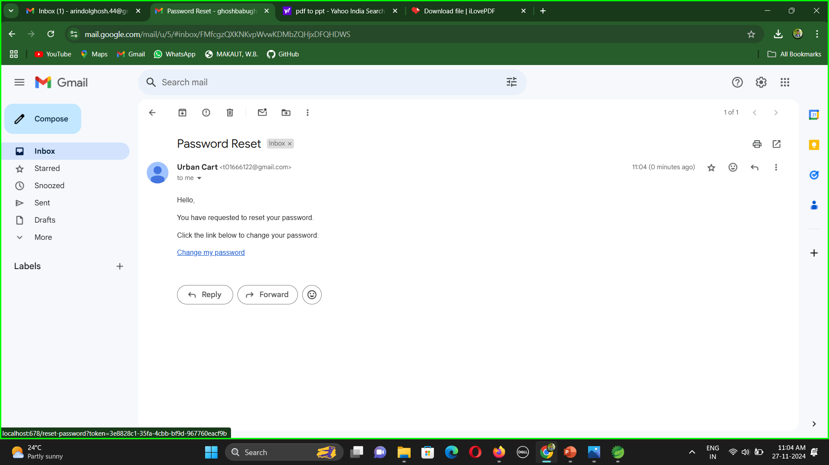

Slide 11
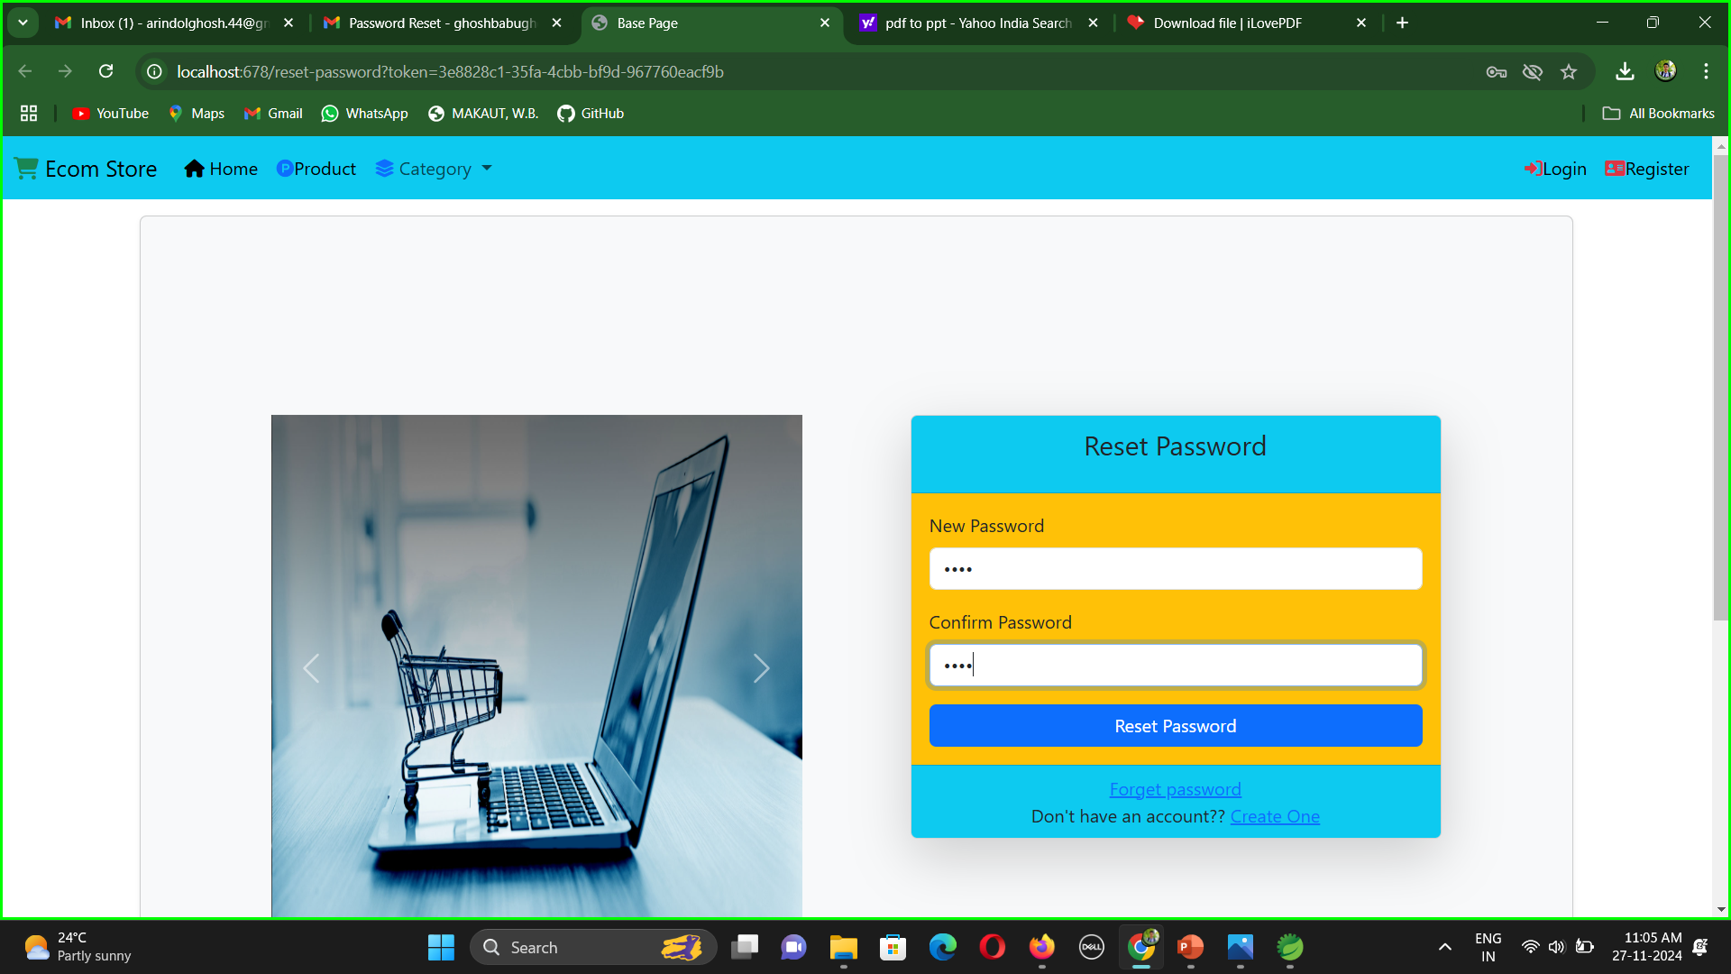

Slide 12
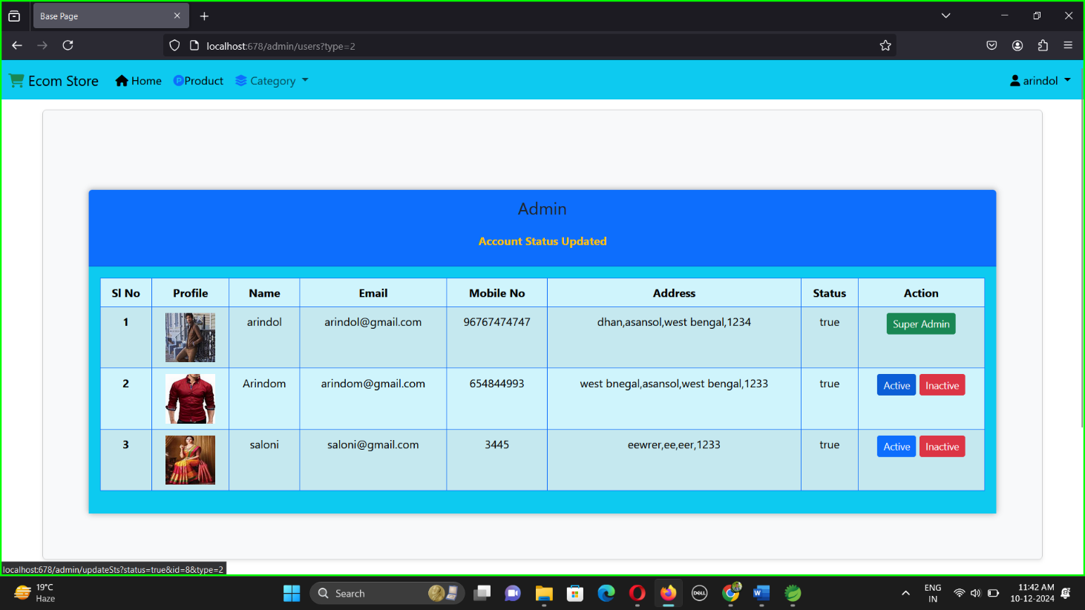
Multiple Admin
Spring Security, a powerful authentication and authorization framework, is used to enforce role-based access. Configure Spring Security to handle authentication (verifying user identity) and authorization (granting or denying access based on roles). You can define security rules in a configuration class by extending WebSecurityConfigurerAdapter and overriding the configure method to specify access controls. For instance, you can restrict access to certain endpoints so that only users with the ADMIN role can access administrative functionalities, while regular users can access general features.
In addition to role-based access control, it is crucial to implement user management features such as registration, login, and profile management. This typically involves creating user registration and login forms, handling user authentication, and managing user sessions.

Slide 13
Spring Boot FrameWork Infrastructure
Auto-Configuration: Automatically configures the application based on
its dependencies, reducing boilerplate code and manual setup.
Embedded Server: Comes with embedded servers like Tomcat or Jetty, enabling standalone
deployment without external configuration.
Spring Ecosystem Integration: Seamlessly integrates with Spring components
like Spring Data, Spring Security, and Spring Cloud.
Dependency Management: Uses Maven or Gradle for easy dependency
resolution and management.
RESTful API Support: Simplifies the development of RESTful services with annotations like
@RestController.
Actuator for Monitoring: Provides built-in tools for monitoring and managing applications in production.
Microservices-Friendly: Ideal for creating distributed systems using Spring Cloud for service discovery, load balancing, and fault tolerance.

Slide 14
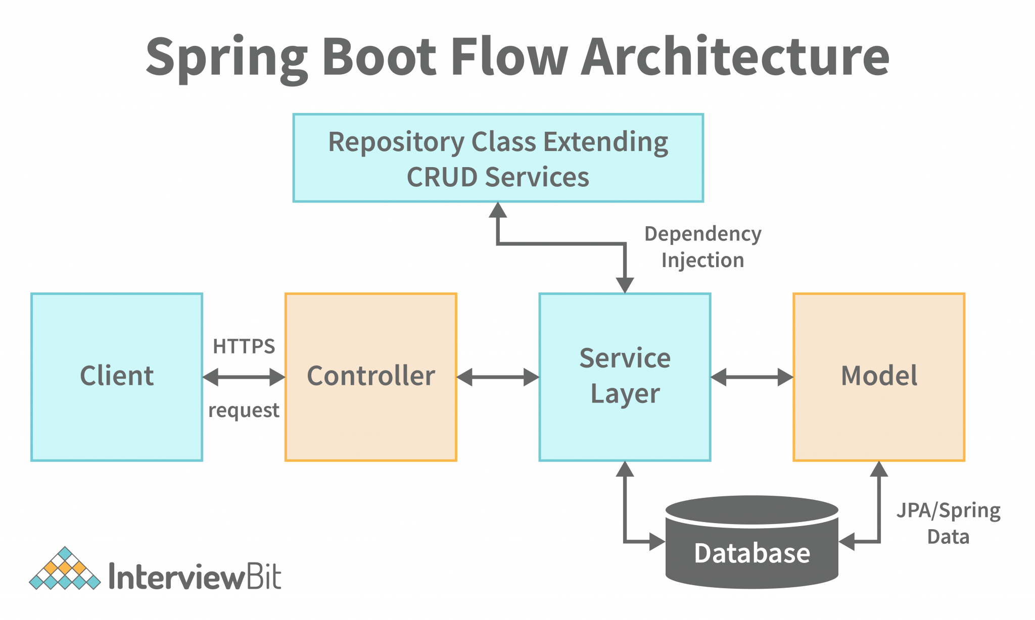

Slide 15
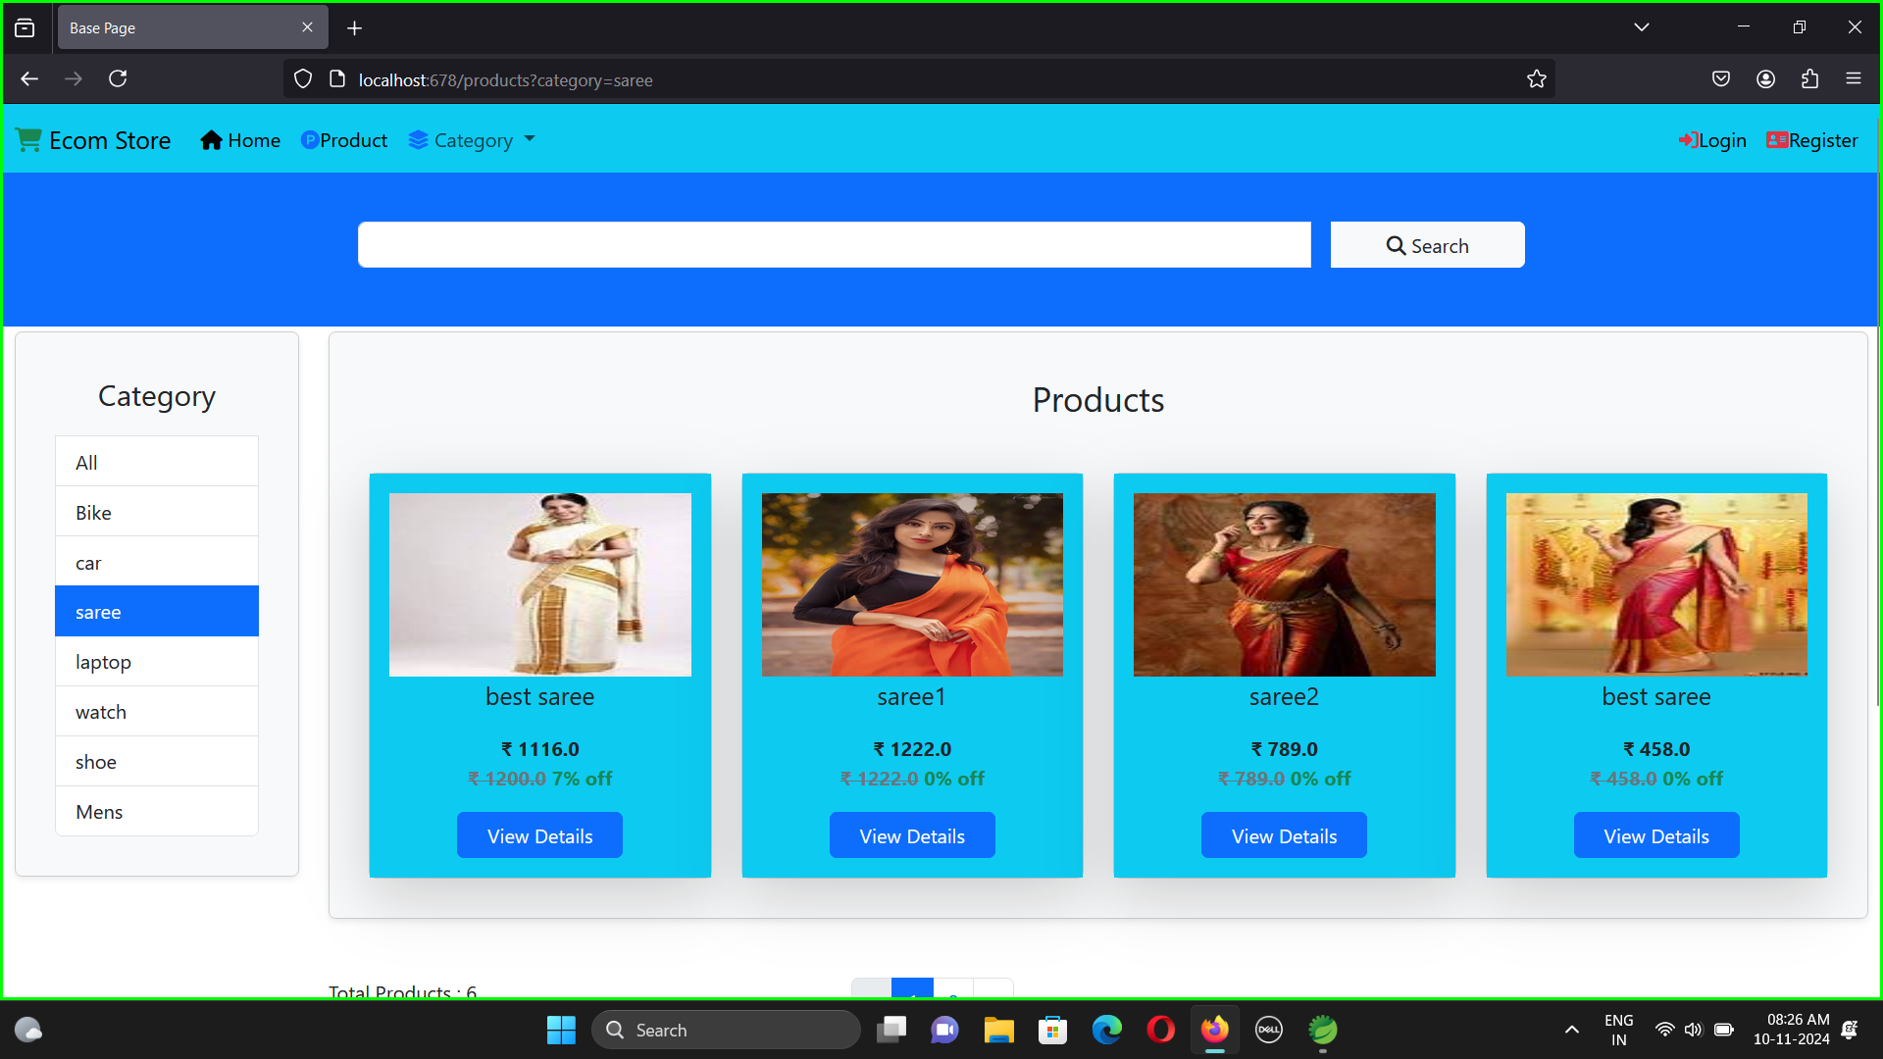
FUNDAMENTAL FEATURES
Search bar:-
In a Spring Boot application, a search bar enhances user experience by enabling efficient data retrieval. It involves designing a frontend form using HTML, connecting it to a controller to process search requests, and using a service layer to fetch database results via JPA or SQL. The controller forwards results to the view layer for display. Integration with Thymeleaf or REST APIs, along with pagination, sorting, validation, and error handling, ensures seamless functionality.

Slide 16
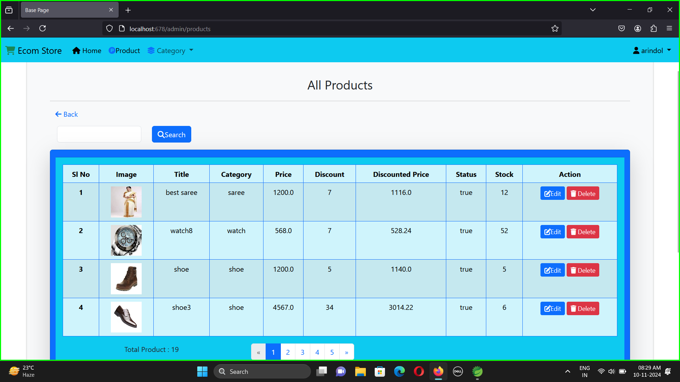

Slide 17
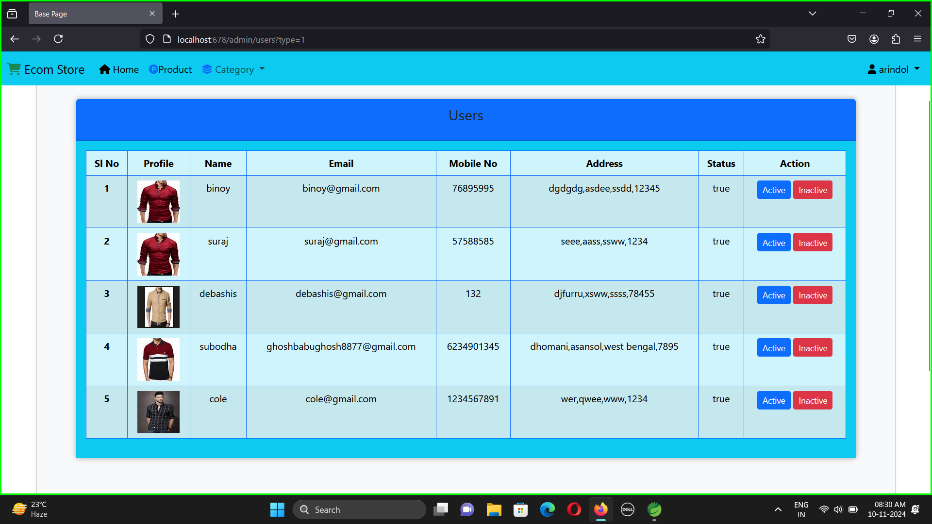
Multiple User:-
In a Spring Boot application, managing multiple user roles, like USER and ADMIN, involves using Spring Security for authentication and role-based access control. Define roles, configure security rules, and implement features like registration, login, and profile management for efficient user role handling.

Slide 18
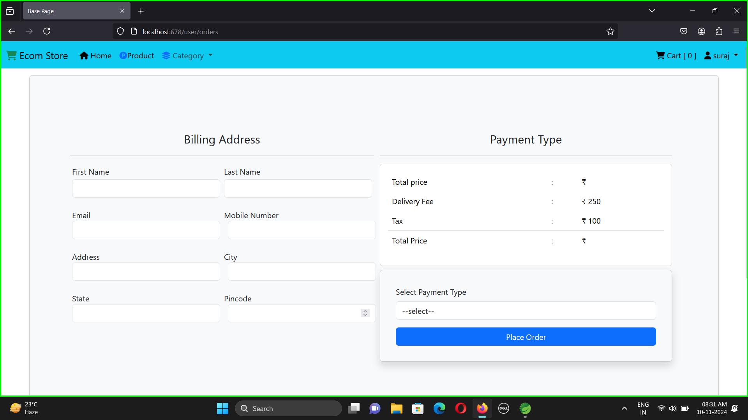
Payment Gateway
Integrate a payment gateway in Spring Boot using REST APIs, secure transactions, and services for payment processing and validation.

Slide 19
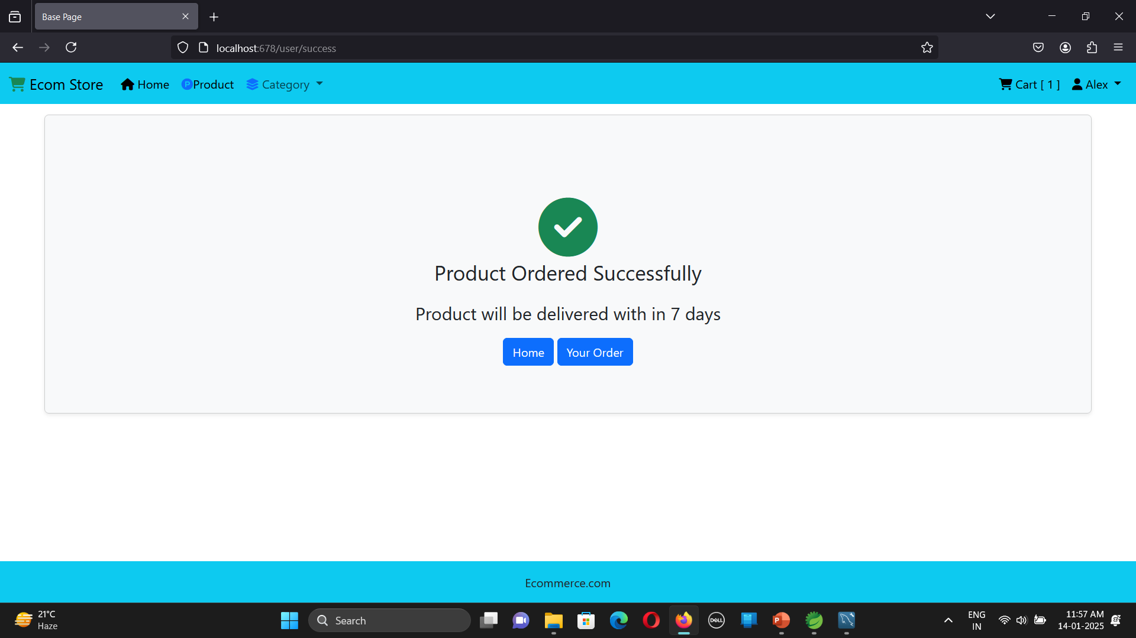
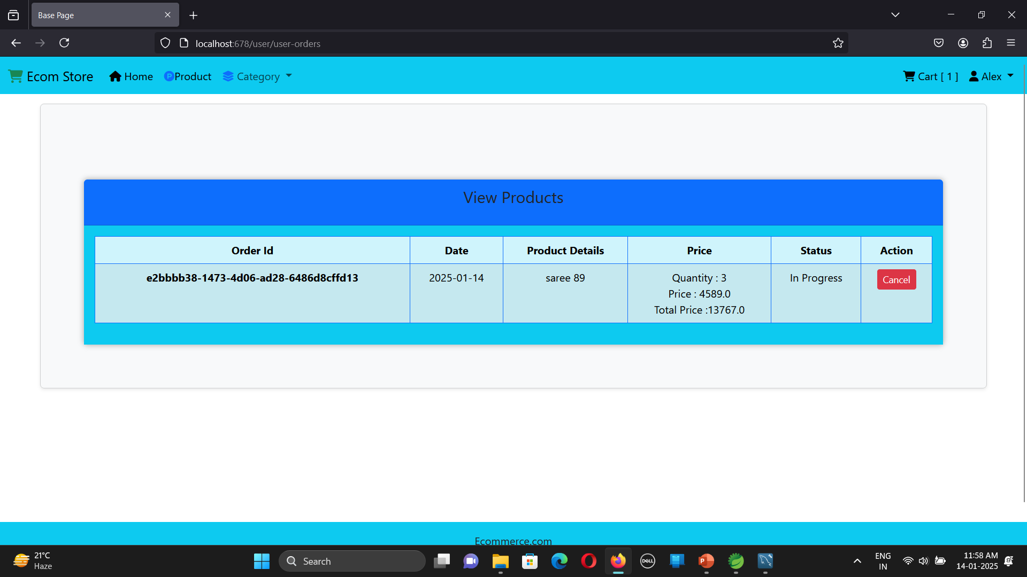
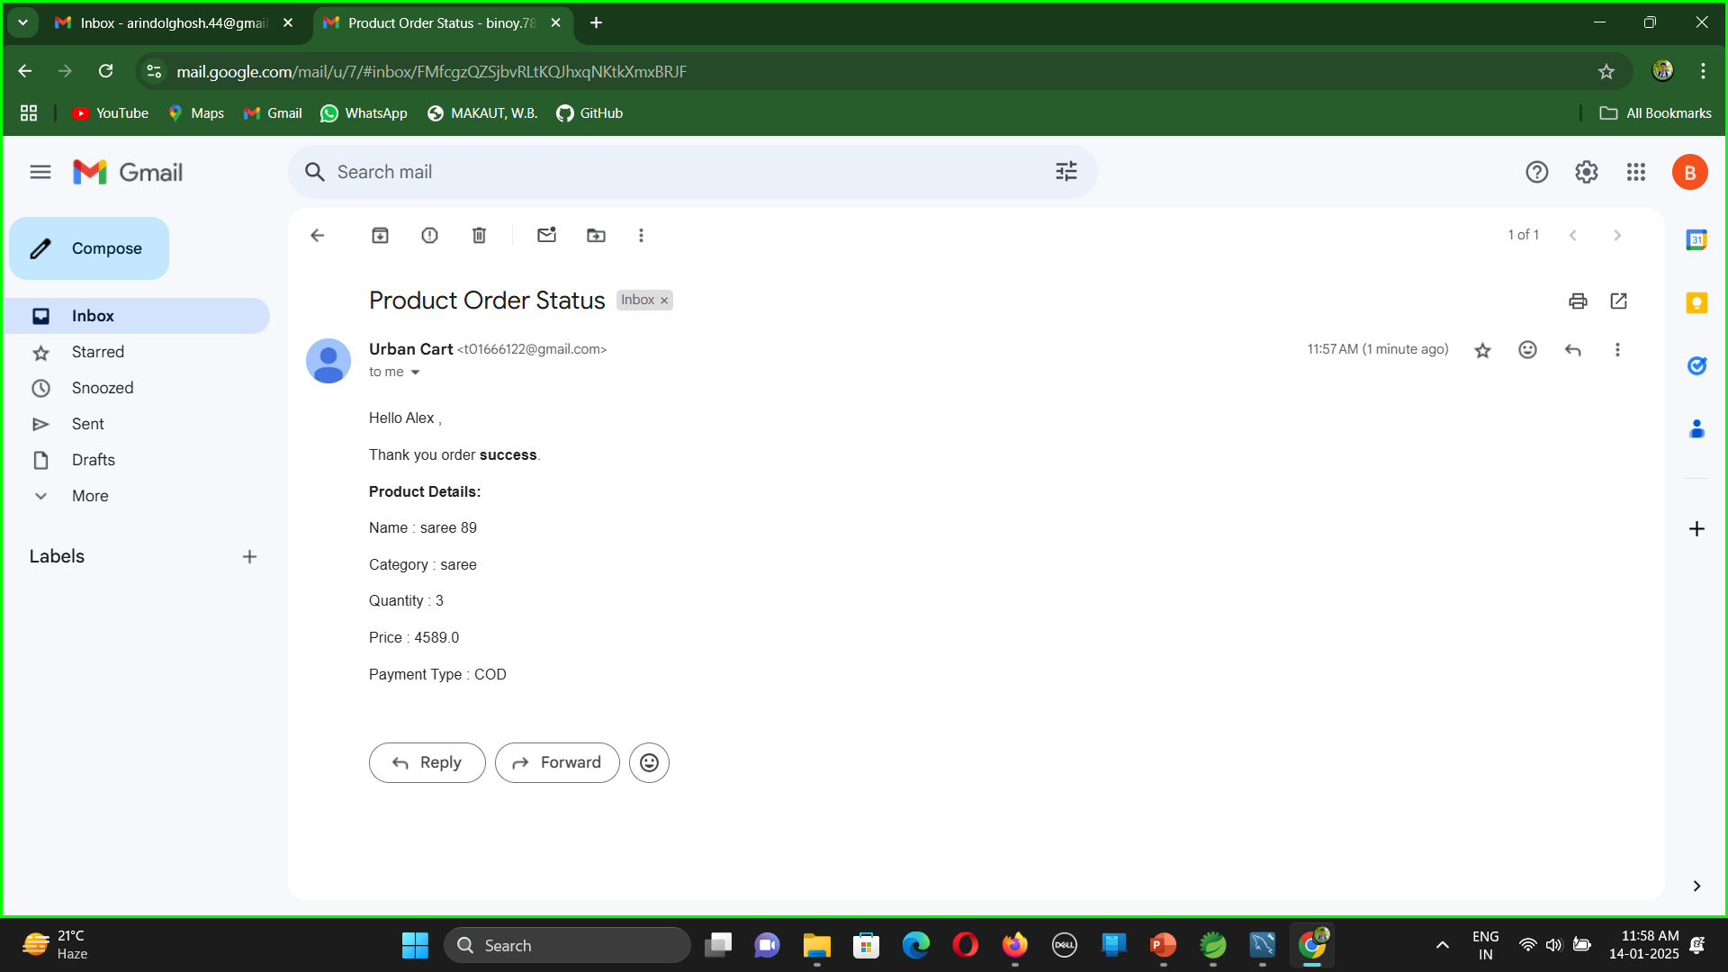

Slide 20
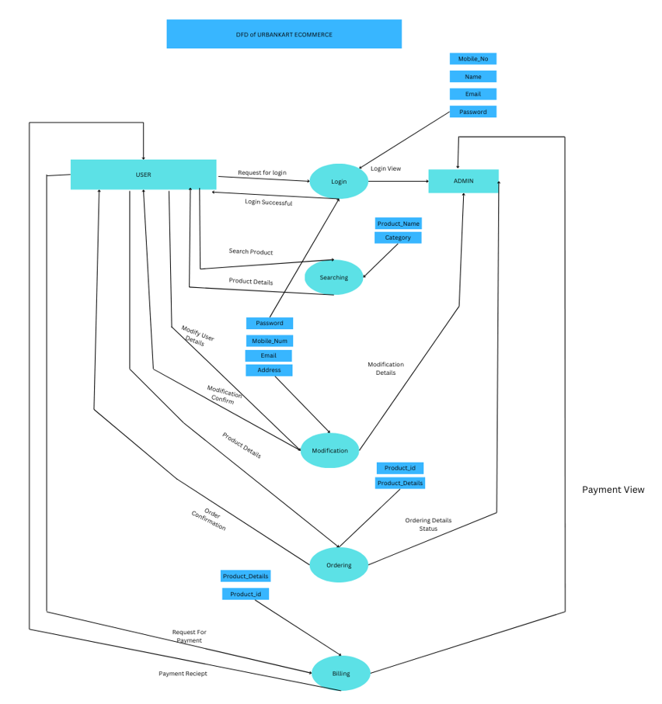

Slide 21
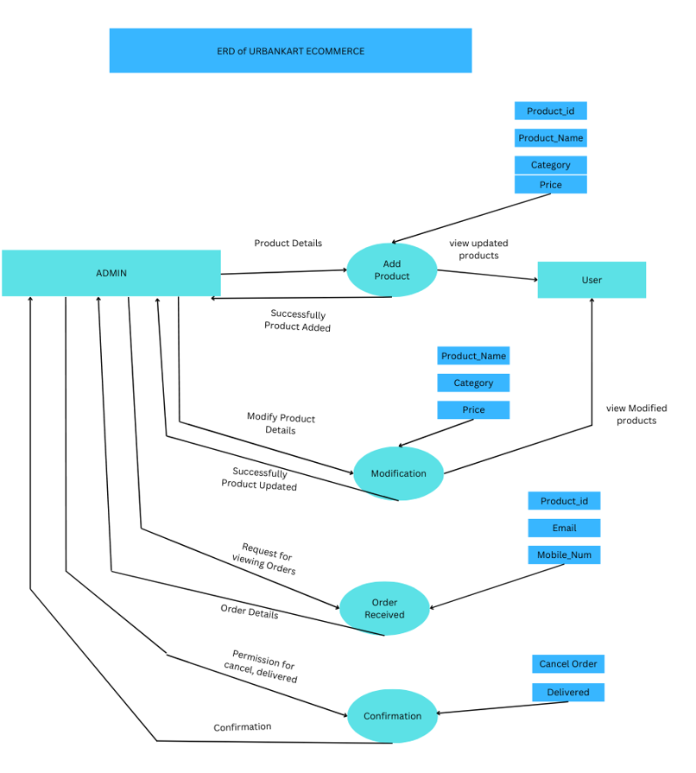

Slide 22
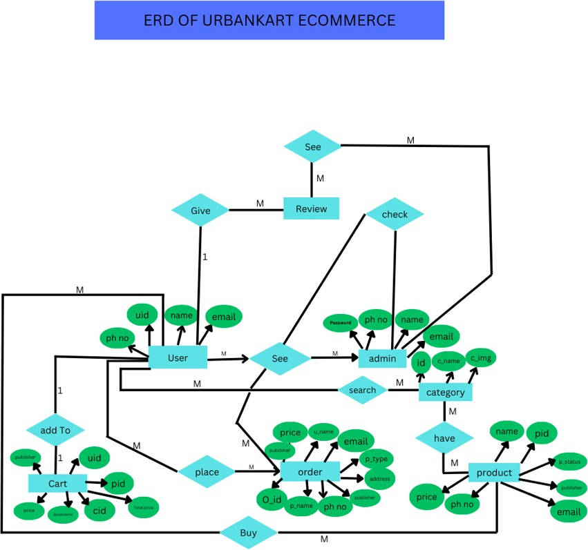

Slide 23
Result & Conclusion
This e-commerce project successfully integrated Spring Boot for backend logic, database interactions, and RESTful services with React for a responsive, dynamic frontend. Key features include secure user management, product catalog CRUD operations, a dynamic shopping cart, payment gateway integration, and order tracking. Servlet JSP, HTML, and CSS ensured seamless server-side logic and design. The project optimized performance, offering a scalable, user-friendly platform, laying a foundation for future enhancements like AI recommendations.

Slide 24
THANK YOU

